Slide 1

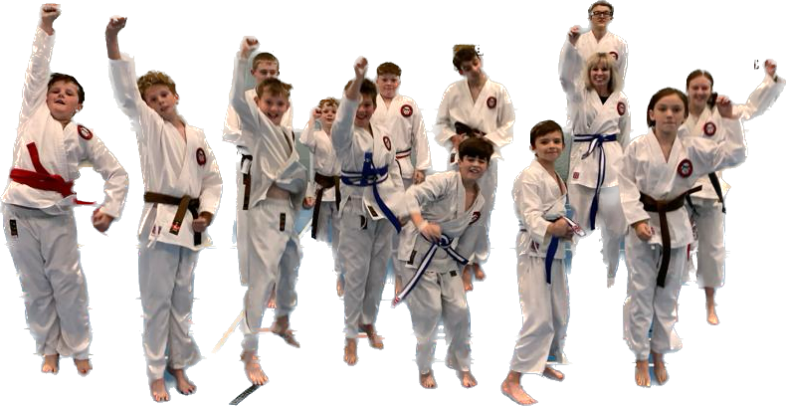
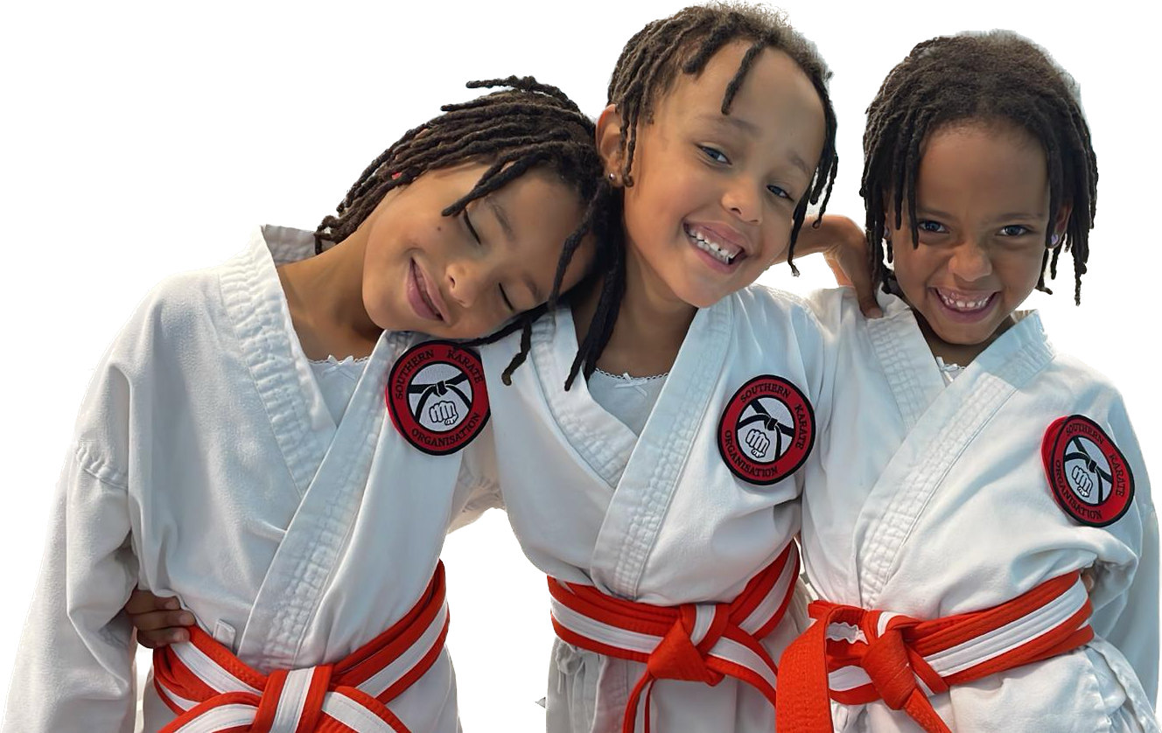
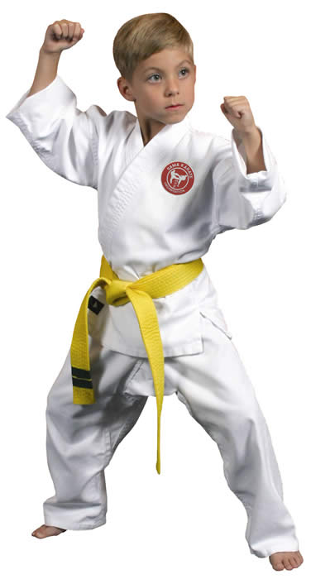
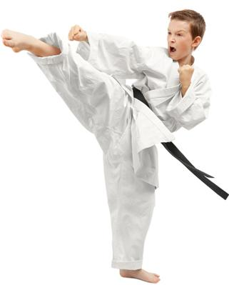


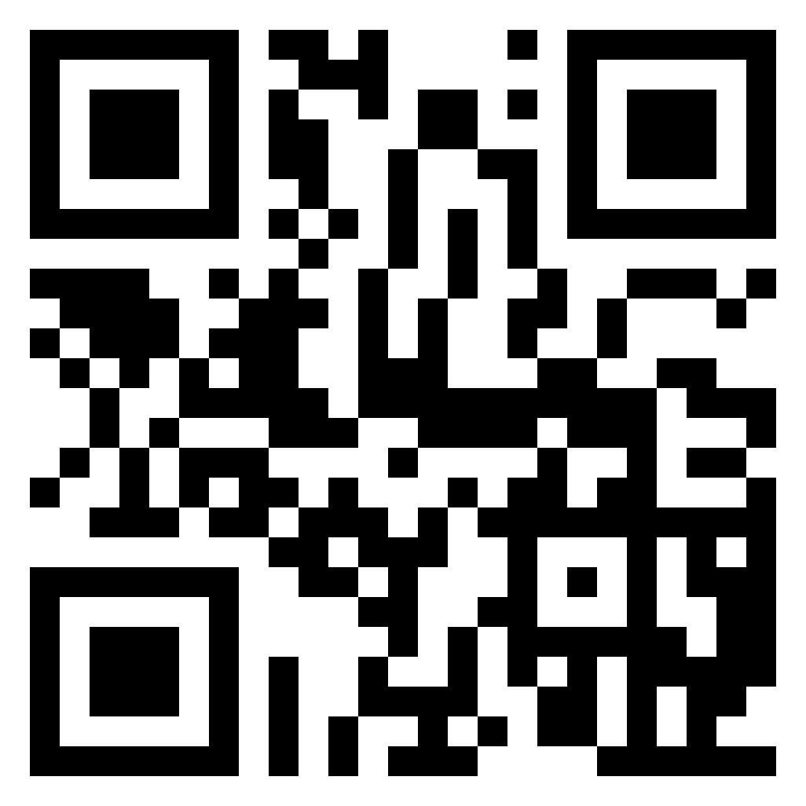




NON CONTACT KARATE TAUGHT BY fully QUALIFIED INSTRUCTORS
EVERYONE WELCOME
FROM 4 YEARS OLD
WE TEACH TRADITIONAL KARATE ENCOURAGING CONFIDENCE, RESPECT, DISCIPLINE, SELF AWARENESS AND AGILITY IN A FUN & CONTROLLED ENVIRONMENT. All classes are friendly, informative & cater to the individual needs of the student.
FOXHILLS JUNIOR SCHOOL
MONDAYS 3.15PM – 4.15Pm
Juniors £6.00 PER CLASS – pay as you go
membership required after first class - juniors £25 PER YEAR
MANY MORE CLASSES TO CHOOSE FROM, FIND THEM ALL AT: WWW.SOUTHERNKARATE.ORG
FOR MORE INFORMATION AND TO BOOK YOUR PLACE
EMAIL: info@southernkarate.org
Tel: 07764 478507

